Slide 1
CROP-seq – Pooled CRISPR screening with single-cell transcriptome readout
Single Cell Sequencing Meeting
20.04.2017
Leuven, Belgium
Paul Datlinger, Christoph Bock Lab, Vienna, Austria

Slide 2
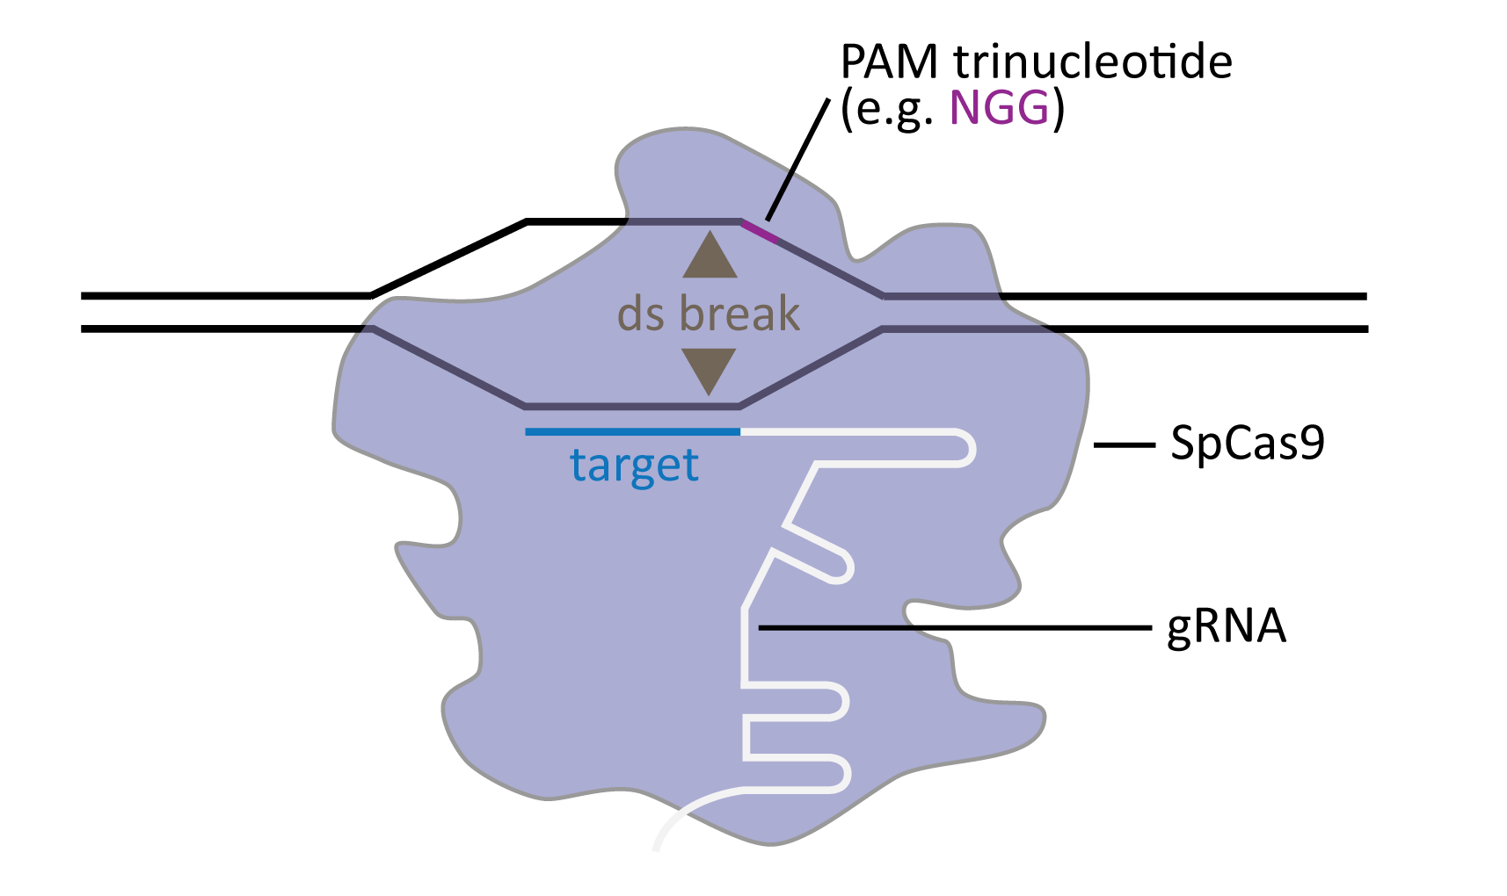
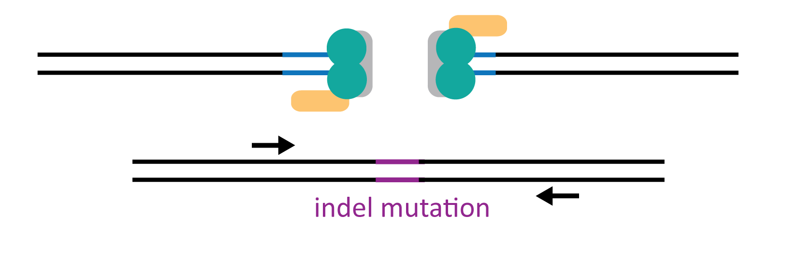
CRISPR is transforming biology
Cleavage by Cas9
Indel formation

Slide 3
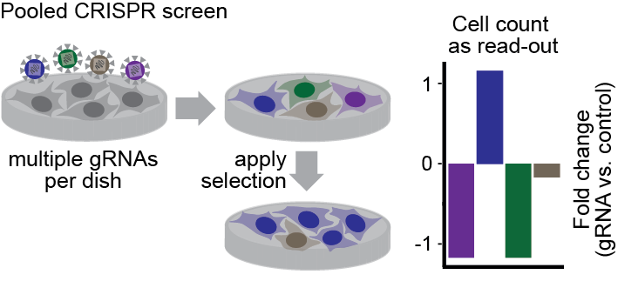
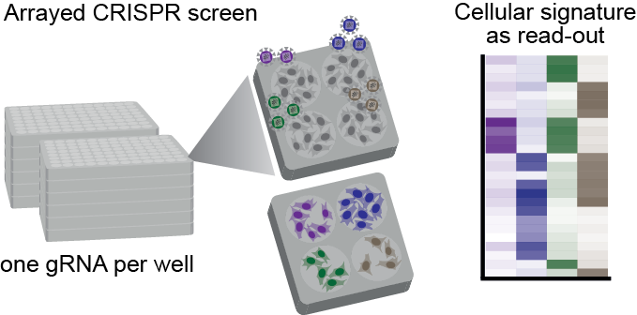


Current limitations of CRISPR screens
High throughput
Complex readout
Simple readout
Relatively low throughput
Interrogates pool of cells
Interrogates pool of cells
Challenging for scarce material
Challenging for scarce material
How to combine the strengths of pooled and arrayed screens?
Can we achieve single-cell resolution?

Slide 4
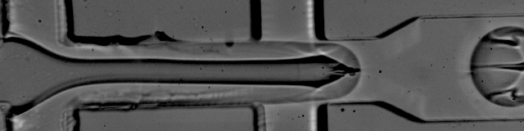
Single-cell RNA-seq in microfluidic droplets
Drop-seq (Macosko et al., 2015)
Microfluidics setup
1k droplets / second

Slide 5
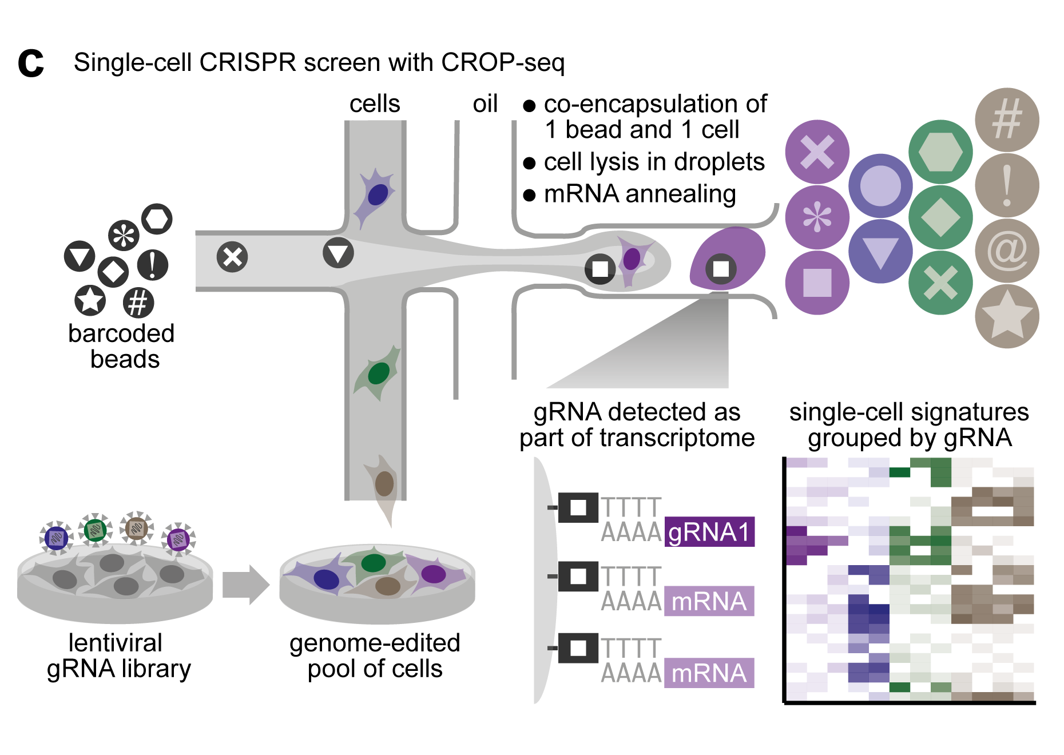
Single-cell CRISPR screens
➔ How to detect gRNAs from single-cell transcriptomes?

Slide 6
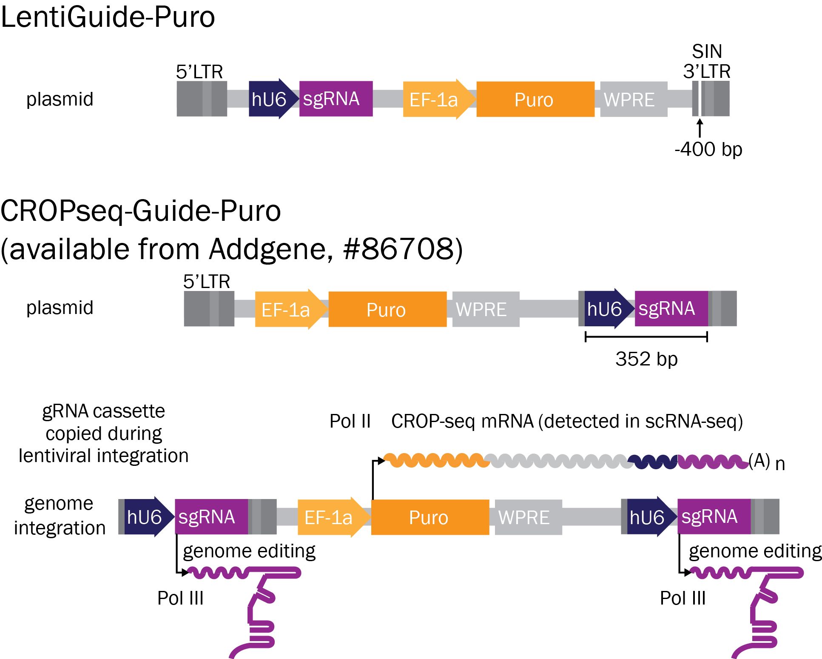
CROPseq-Guide-Puro plasmid design

Slide 7
CROPseq-Guide-Puro plasmid design
CROP-seq (“CRISPR droplet sequencing”) - Datlinger et al., Nature Methods 2017

Slide 8
CROPseq-Guide-Puro plasmid design
CROP-seq (“CRISPR droplet sequencing”) - Datlinger et al., Nature Methods, 2017

Slide 9
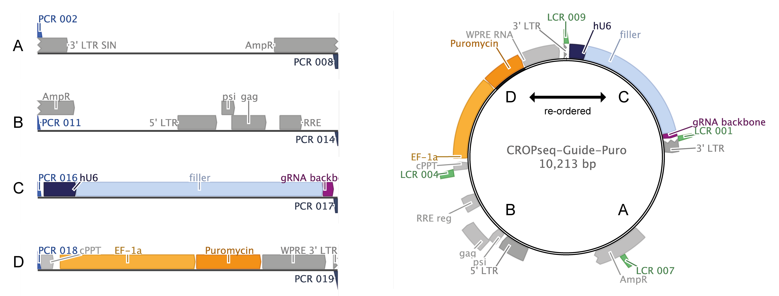
Plasmid construction via Ligase Cycling Reaction
De Kok et al., ACS Synthetic Biology, 2014

Slide 10
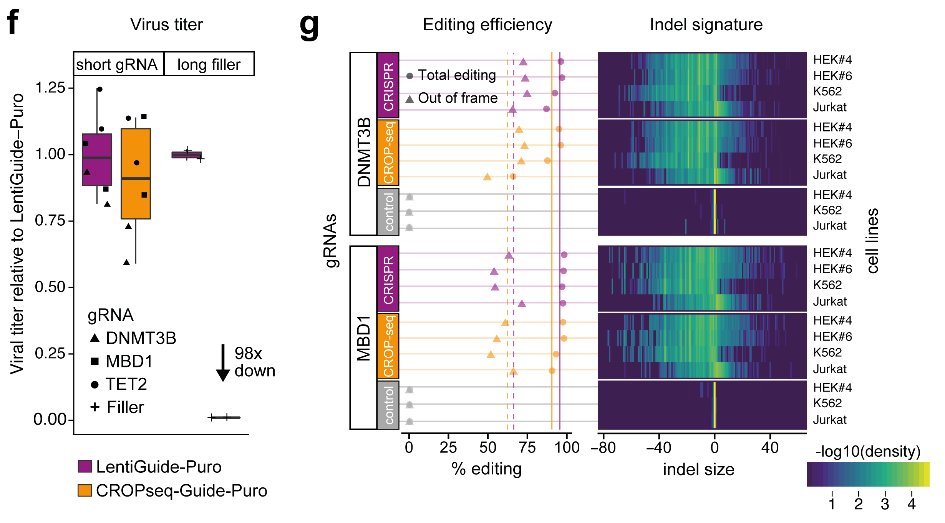
Suitability for pooled screening

Slide 11
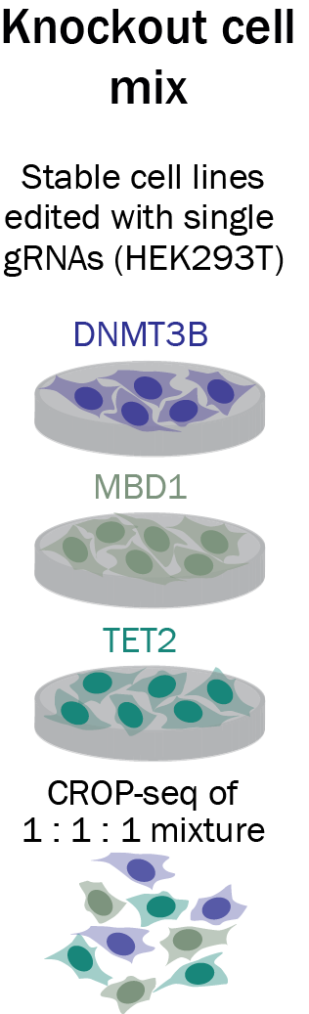
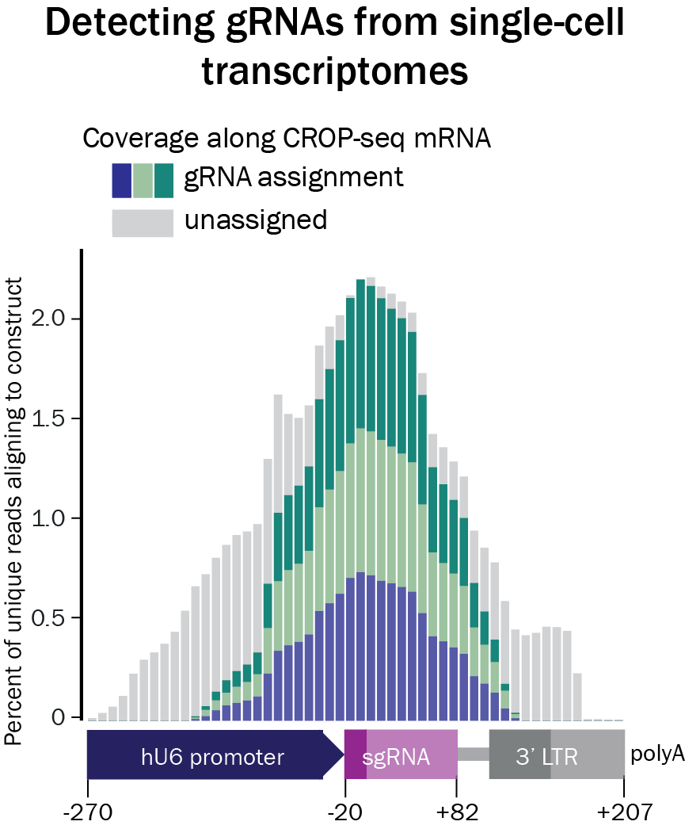
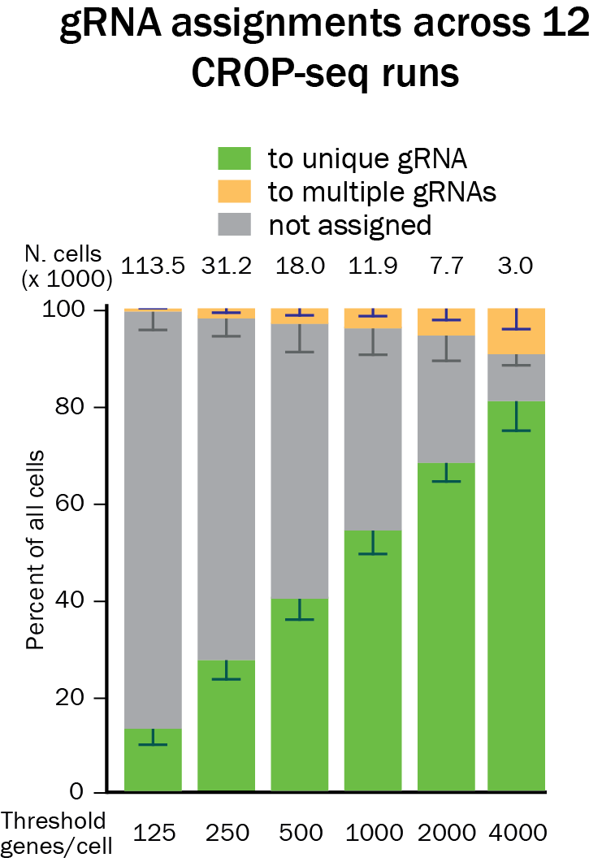
CROP-seq detects gRNAs in single-cell transcriptomes
Notes:
multiple gRNAs duplets!
most abundant gRNA was assigned. Most cells had only one molecule detected in screen

Slide 12
CROP-seq reads the gRNA directly
Alternative methods Perturb-seq – Aviv Regev and Jonathan Weissman labs (Dixit et al, 2016; Adamson et al, 2016) CRISP-seq – Ido Amit lab (Jaitin et al, 2016) Mosaic-seq – Gary Hon lab (Xie et al, 2017)
Image taken from: Wagner and Klein, Nature Methods, 2017
Notes:
multiple gRNAs duplets!
most abundant gRNA was assigned. Most cells had only one molecule detected in screen

Slide 13
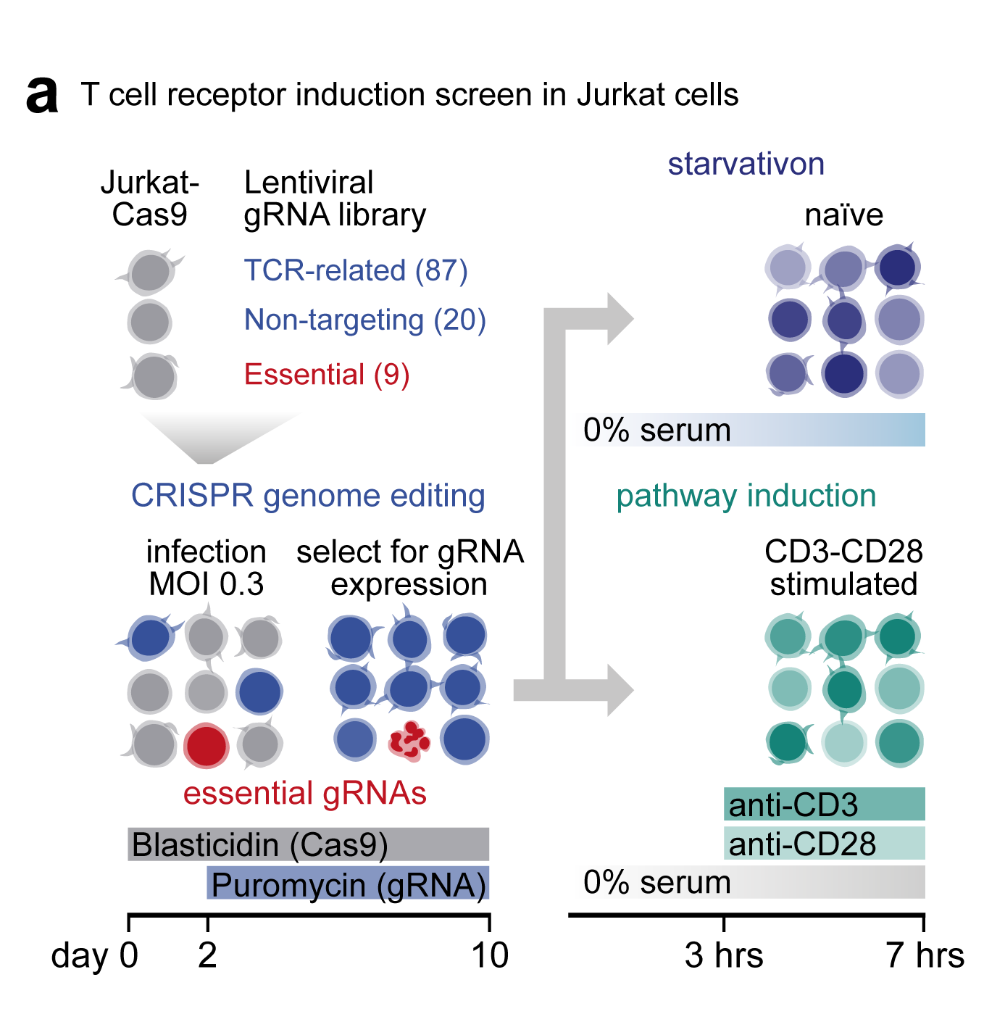
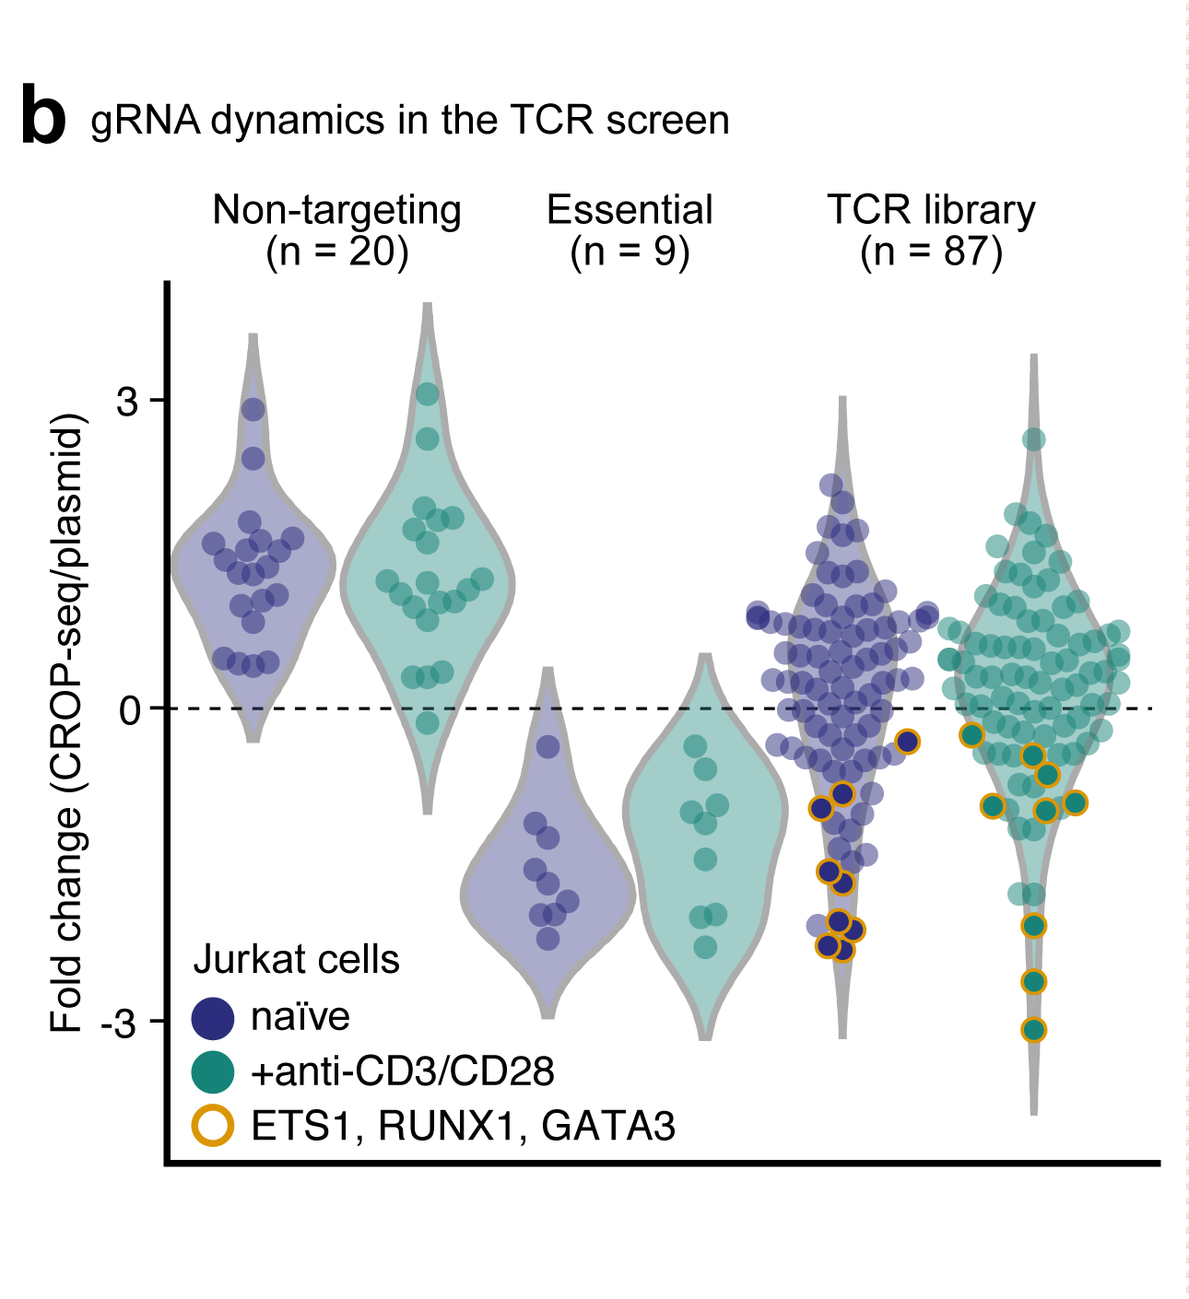
T cell receptor induction screen in Jurkat cells

Slide 14
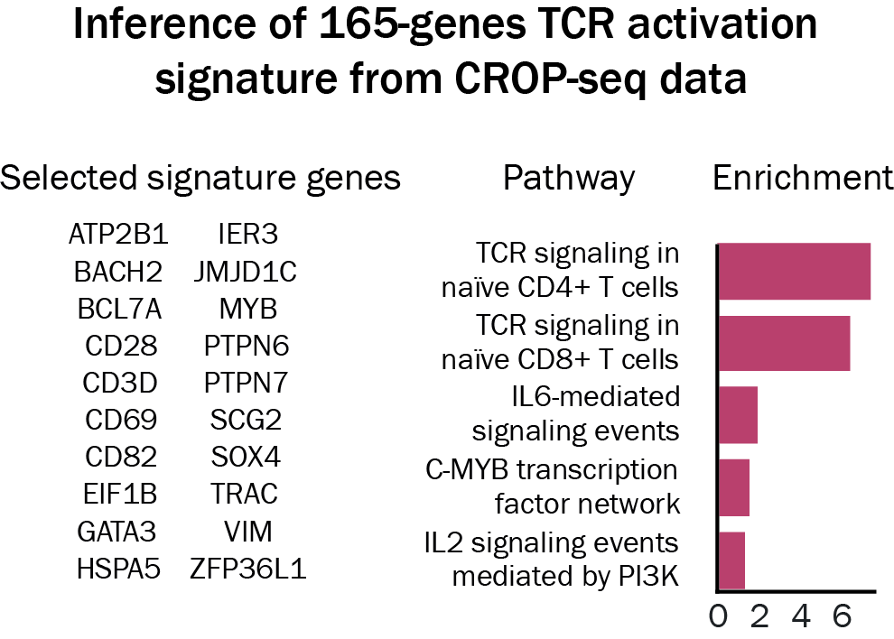
T cell receptor induction screen in Jurkat cells

Slide 15
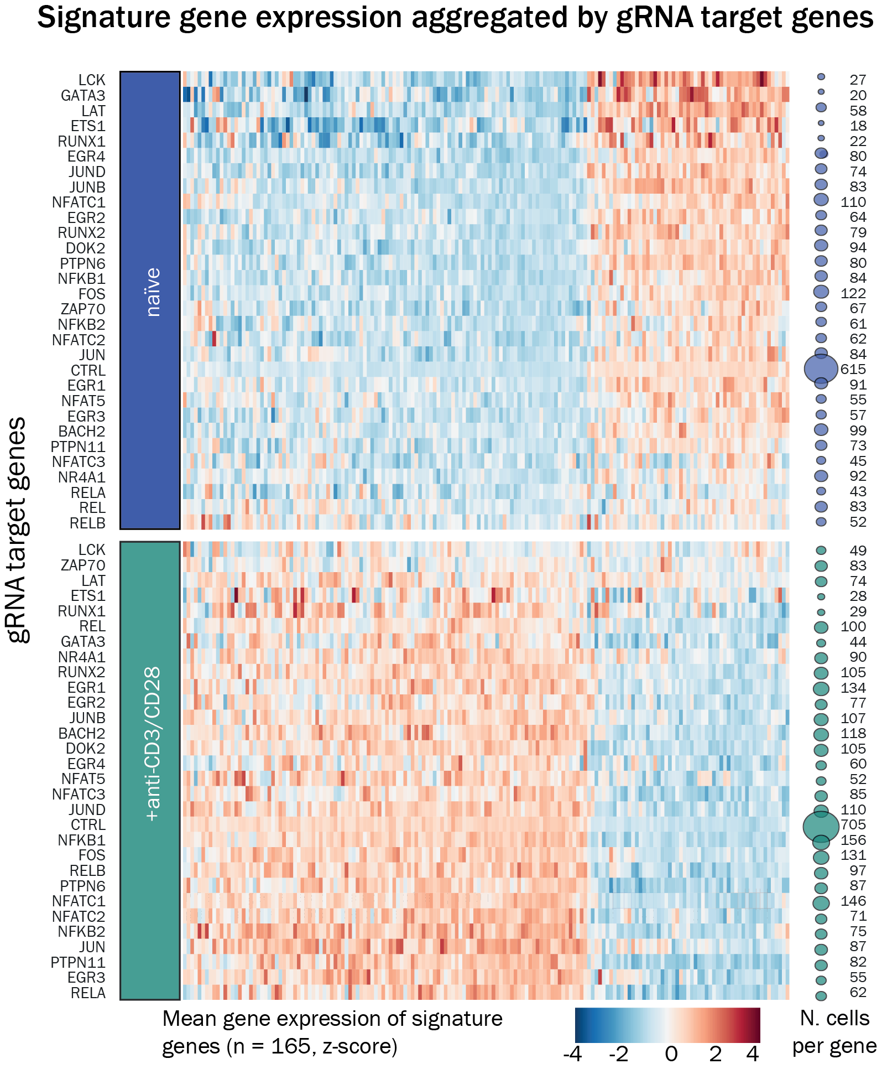
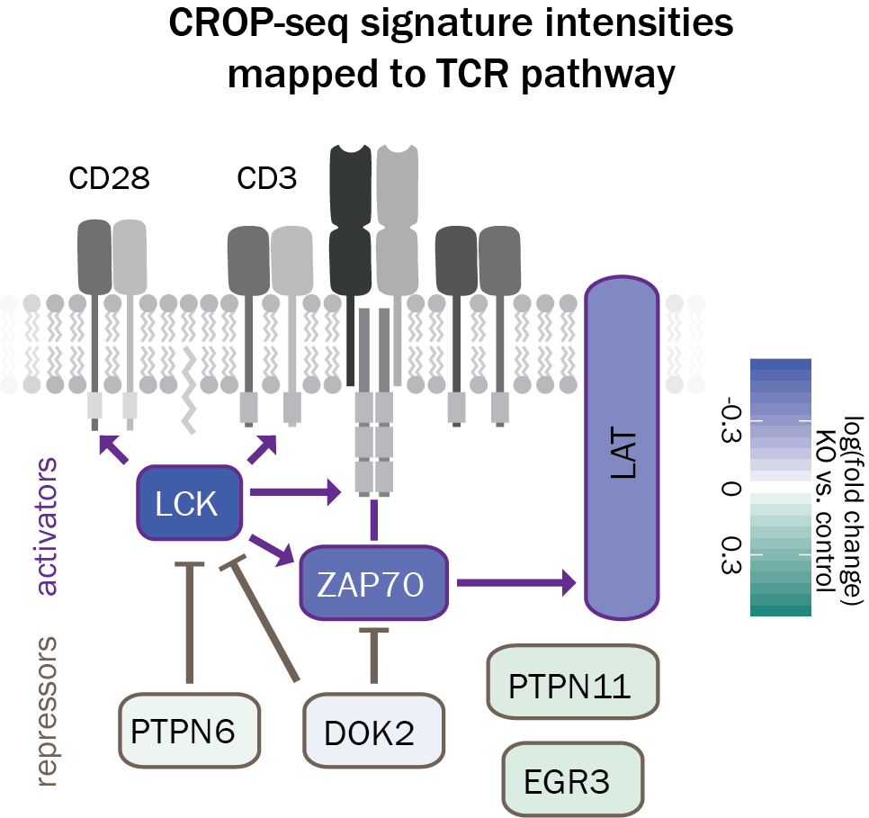
Impact of perturbations on TCR activation signature
Notes:
supp 7a all cells!

Slide 16
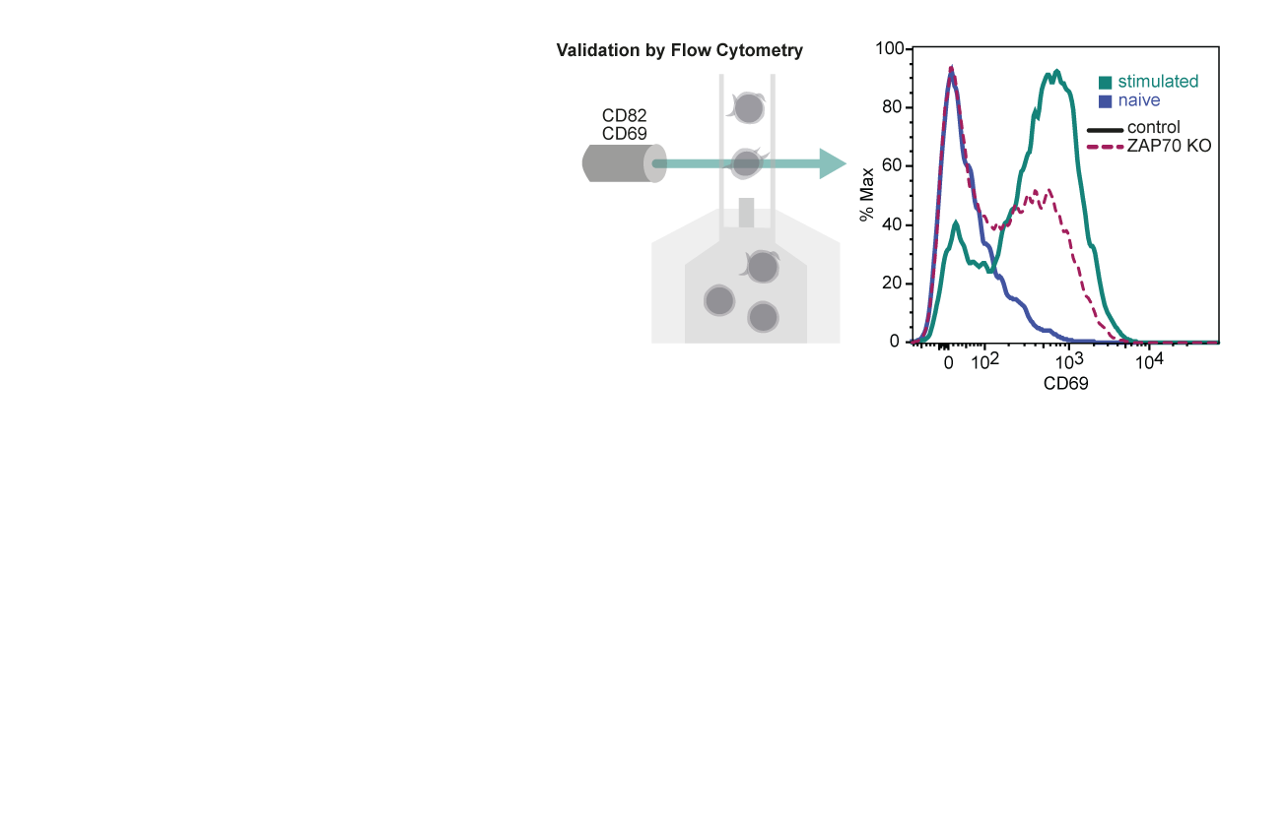
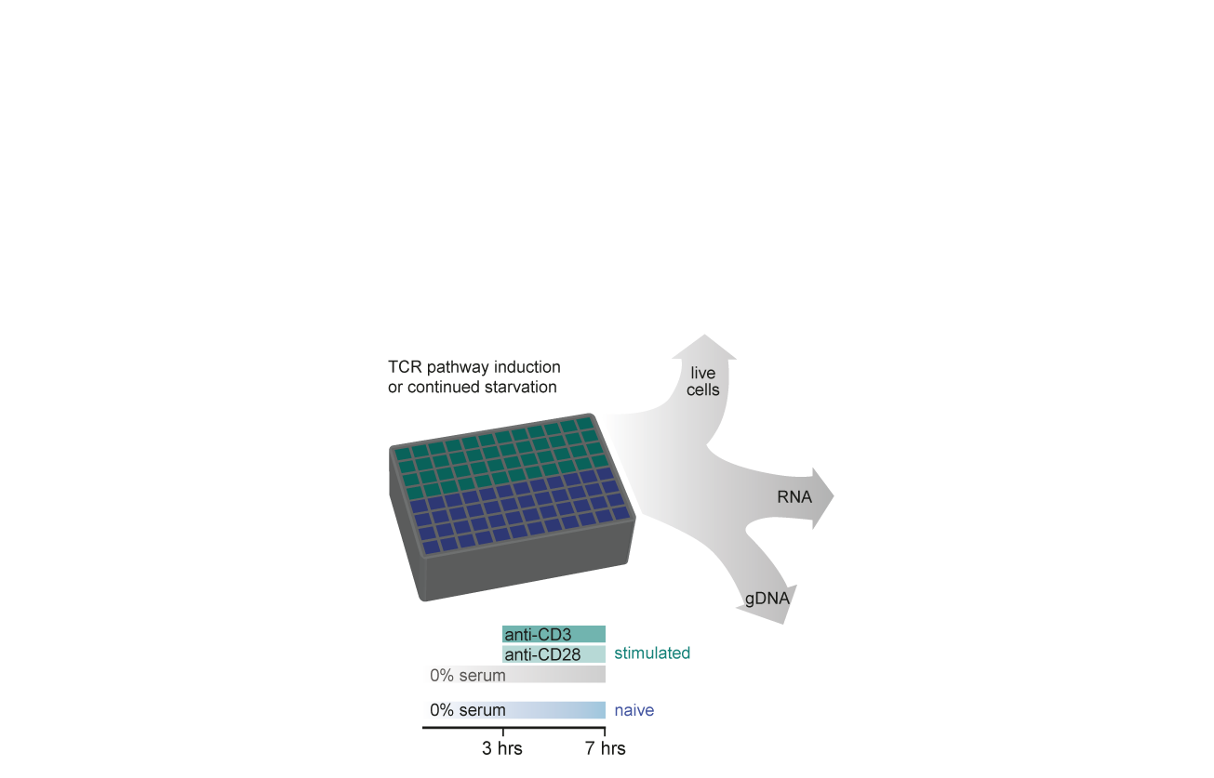
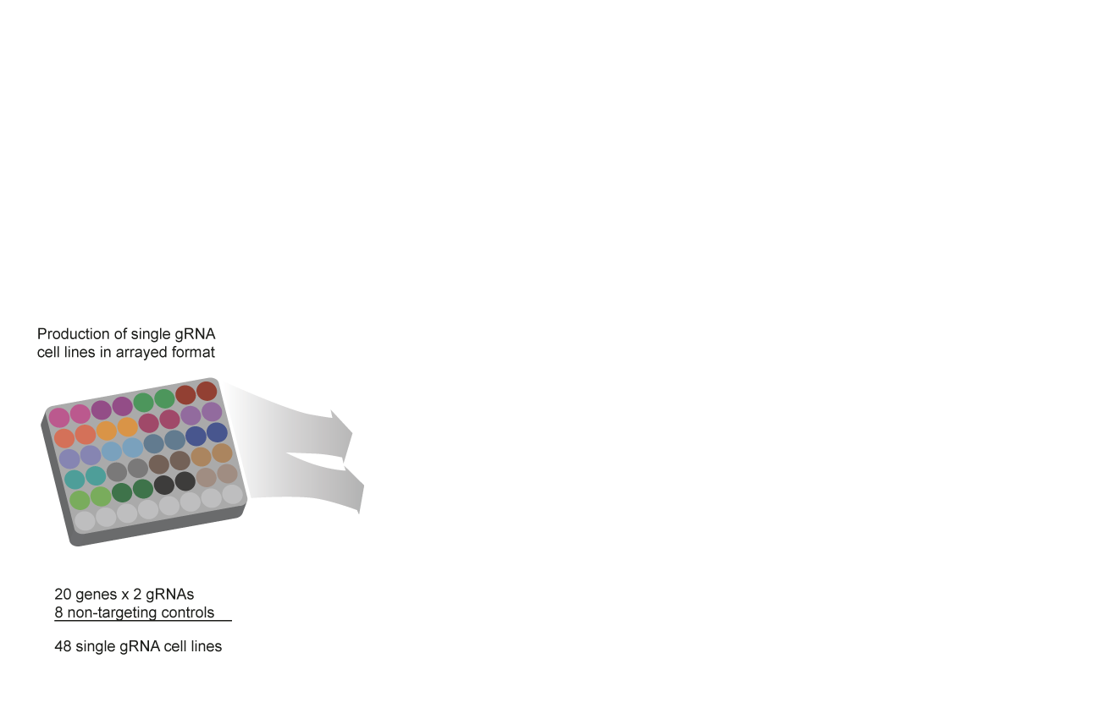
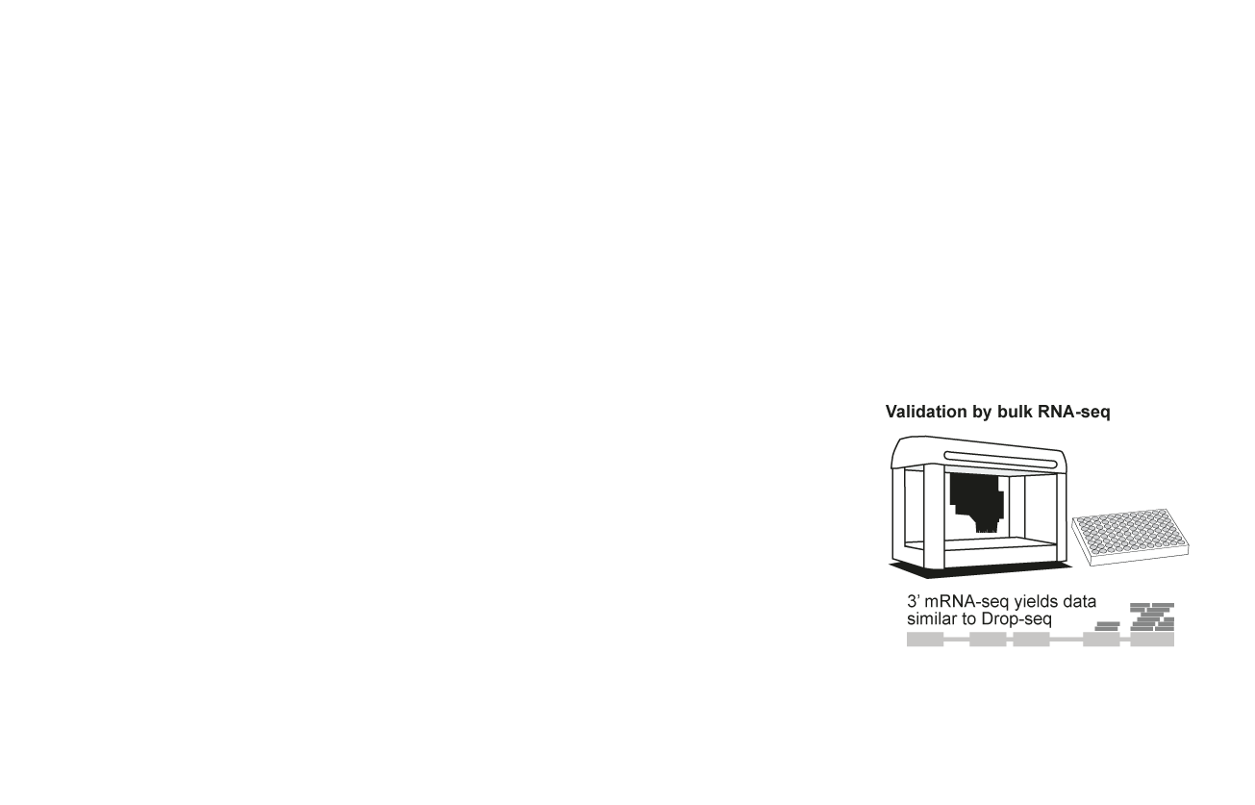
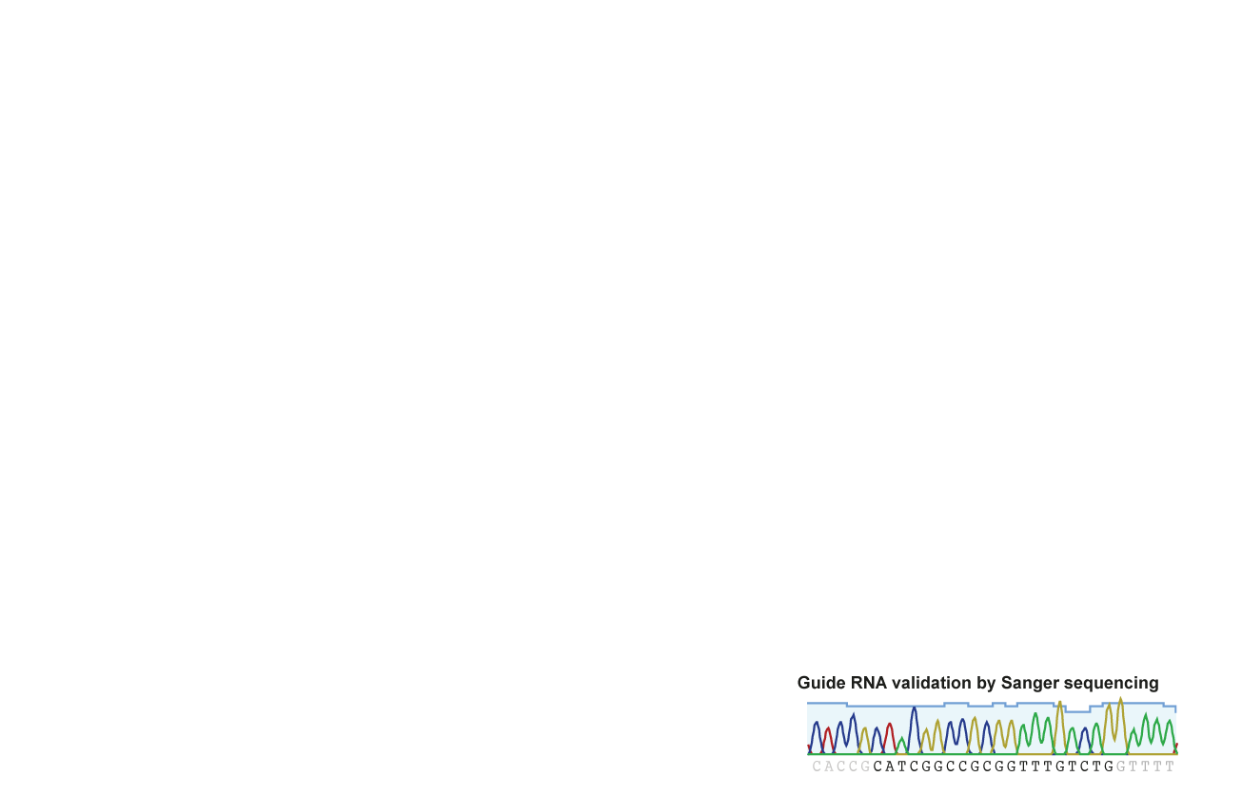
Validation of CROP-seq by an arrayed screen
Notes:
supp 7a all cells!

Slide 17
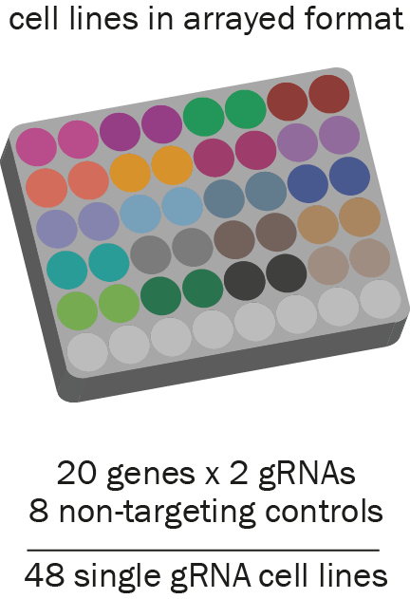
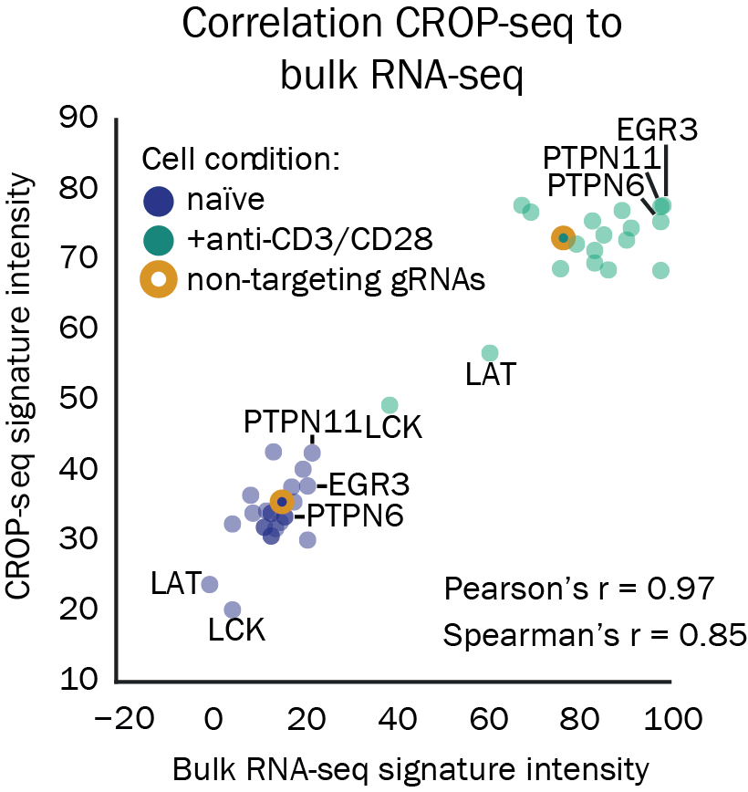
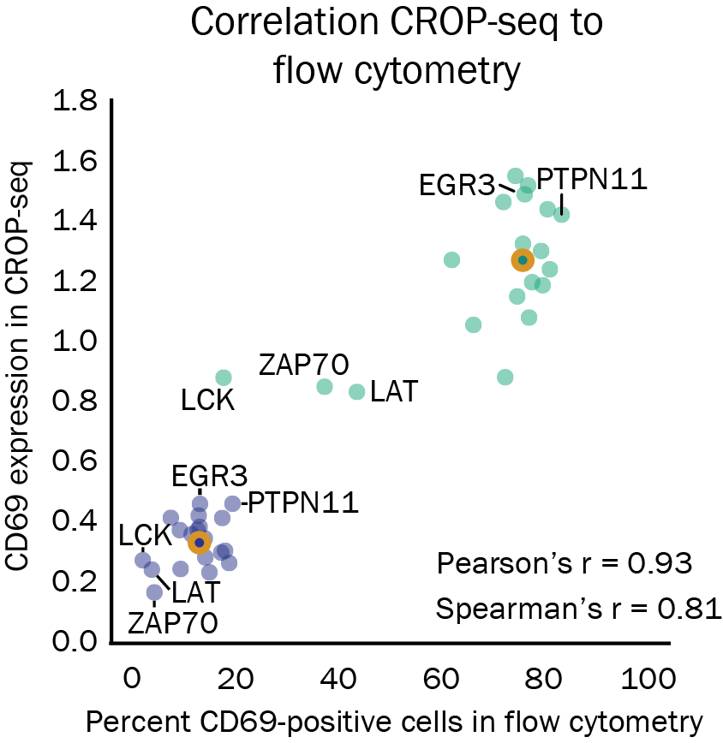
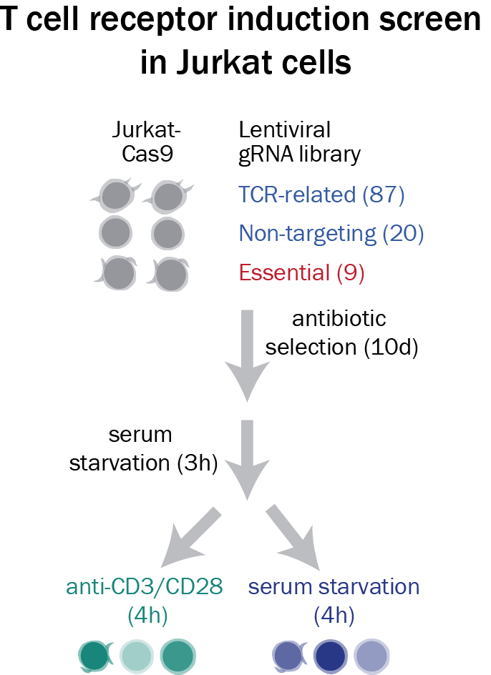
Validation of CROP-seq by an arrayed screen
Arrayed screen setup
Bulk RNA-seq
Flow cytometry

Slide 18
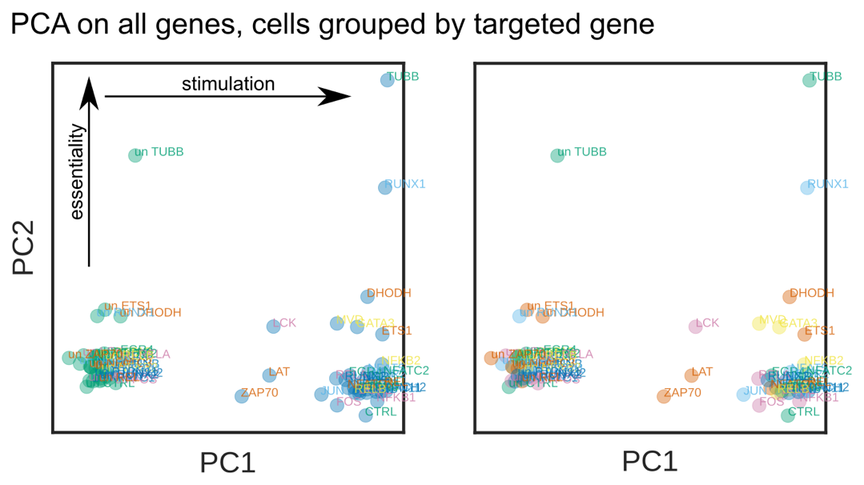
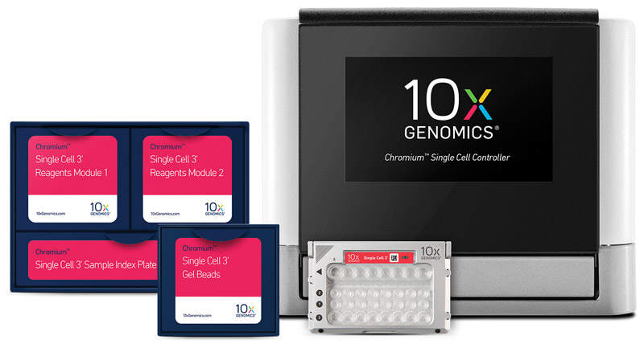
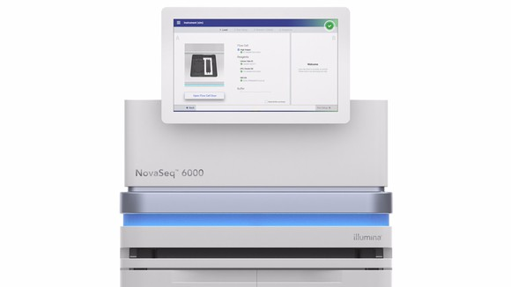
Scaling throughput by using commercial platforms
Scaling scRNA-seq throughput
TCR screen with 10x Genomics
Drop-seq prototype 10,000 cells / day
10x Genomics Chromium platform 80,000 cells / hour
Increased sequencing depth
Illumina Nova-seq platform

Slide 19
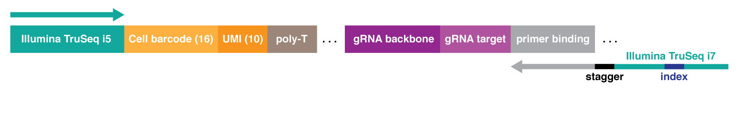
Scaling throughput by gRNA pre-enrichment
453 bp
Ladder
gRNA library

Slide 20
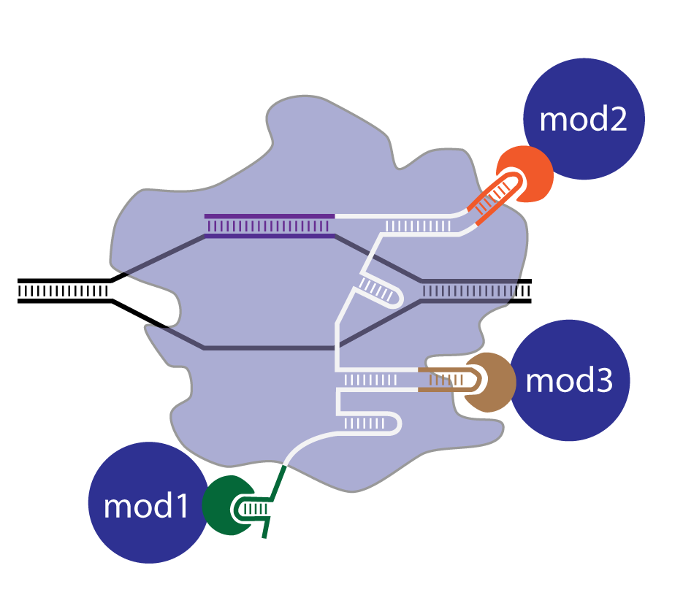
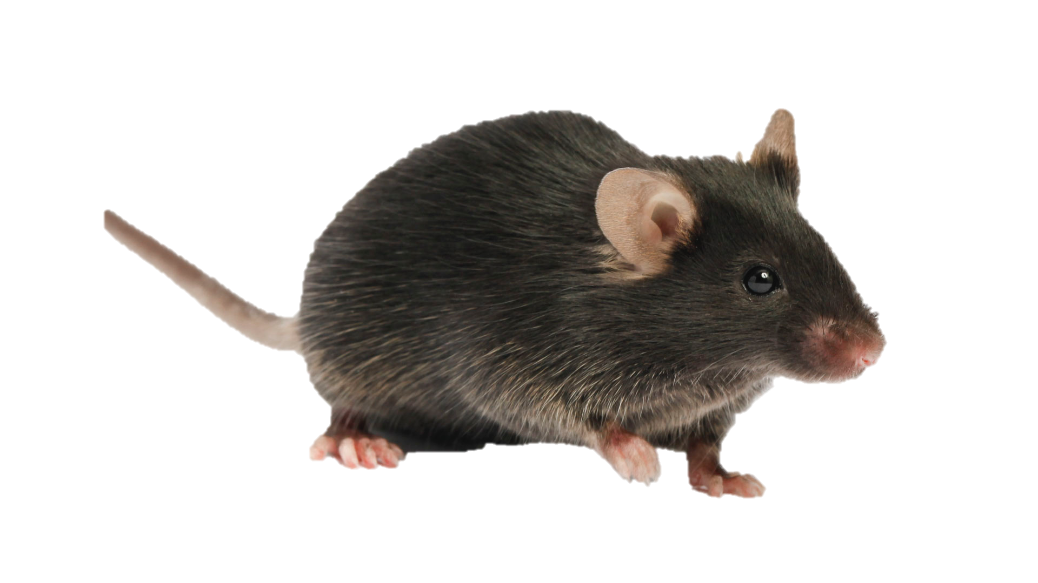
Future directions for CROP-seq
Screens in primary cells*
Expanding the toolbox
Primary cells obtained from Cas9 mouse*
Cas9 expression in hematopoietic stem cells
* CROPseq-Guide-Fluoro available upon request

Slide 21
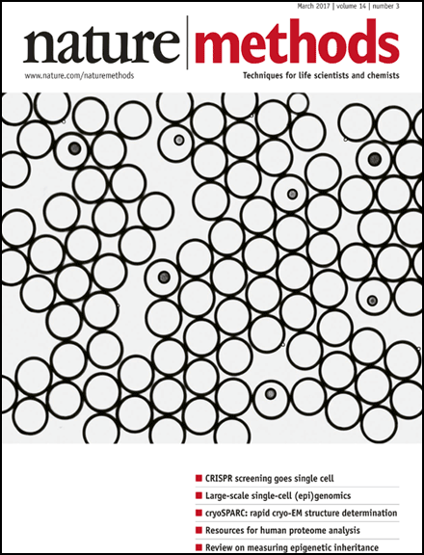

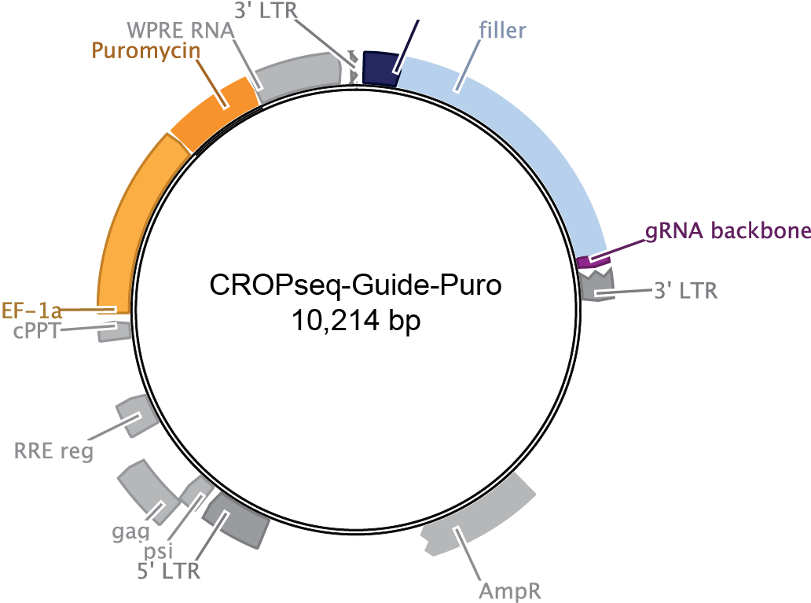
How to implement CROP-seq
CRISPR droplet sequencing (CROP-seq) enables pooled CRISPR screens with single-cell transcriptome resolution
#86708
Detailed open source protocol: http://crop-seq.computational-epigenetics.org
CROPseq-Guide-Puro enables quick and easy cloning of gRNA libraries
gRNAs are detected from an polyA mRNA, compatible with scRNA-seq protocols including commercial solutions
High-throughput phenotypic characterization of knockouts
Datlinger et al., Nature Methods 2017

Slide 22
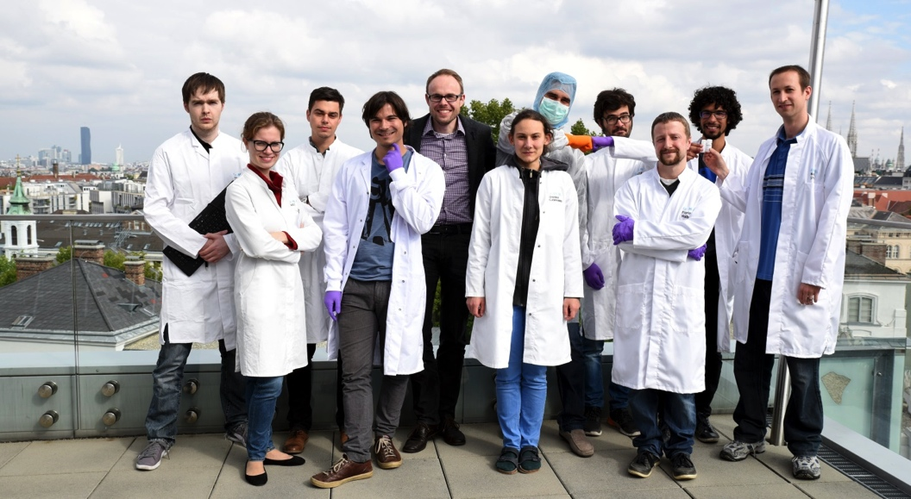



Acknowledgments
Bock lab
Christoph Bock
Paul Datlinger
Matthias Farlik
Florian Halbritter
Johanna Klughammer
Thomas Krausgruber
Amelie Kuchler
André Rendeiro
Linda Schuster
Christian Schmidl
Peter Traxler
Fangwen Zhao
Lion Uhl Nikolaus Fortelny
Biomedical Sequencing Facility
Christoph Bock
Donat Alpar
Charles Dietz
Johanna Hadler
Thomas Penz
Michael Schuster
Heiko Müller
Sneha Datta

